Slide 1
“There is a principle which is a bar against all information, which is proof against all arguments and which cannot fail to keep a man in everlasting ignorance – that principle is contempt prior to investigation.”
– Herbert Spencer

Slide 2
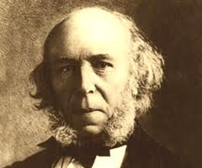
HERBERT SPENCER (1820 - (1820-1903)
HERBERT SPENCER

Slide 3
“THE WORTH OF MEN CONSISTS IN THEIR LIABILITY TO PERSUASION.”
- ALFRED NORTH WHITEHEAD

Slide 4
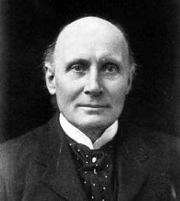
ALFRED NORTH WHITEHEAD (1861 - 1947 )

Slide 5
“KEEP AN OPEN MIND, BUT NOT SO OPEN THAT YOUR BRAINS FALL OUT”
- ALAN ROSS ANDERSON

Slide 6
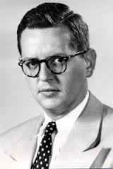
ALAN ROSS ANDERSON (1925 - 1973)

Slide 7
PREMISES
There exist instances of intense suffering which an omnipotent, omniscient Being could have prevented without thereby losing some greater good or permitting some evil equally bad or worse.
(2) An omniscient, wholly good Being would prevent the occurrence of any intense suffering it could , unless it could not do so without thereby losing some greater good or permitting some evil equally bad or worse.

Slide 8
CONCLUSION
There does not exist an omnipotent, omniscient, wholly good Being.

Slide 9
THEIST’S SHIFT-ARGUMENT PREMISES
(NOT-3) There DOES exist an omnipotent, omniscient, wholly good Being.
(2) An omniscient, wholly good Being would prevent the occurrence of any intense suffering it could , unless it could not do so without thereby losing some greater good or permitting some evil equally bad or worse.

Slide 10
THEIST’S SHIFT-ARGUMENT CONCLUSION
(NOT-1) There DO NOT exist instances of intense suffering which an omnipotent, omniscient Being could have prevented without thereby losing some greater good or permitting some evil equally bad or worse.

Slide 11
ROWE’S EVALUATION
PREMISE (1) OF THE INDUCTIVE ARGUMENT FROM EVIL IS MORE REASONABLE THAN PREMISE (NOT-3) OF THE THEIST’S SHIFT-ARGUMENT - GIVEN HIS (ROWE’S) EVIDENCE BAS E.
BUT (SAYS ROWE) SOME THEISTS MAY WELL HAVE A REASONABLE BELIEF IN PREMISE (NOT-3) OF THE SHIFT-ARGUMENT (!!!) – GIVEN THEIR (THE THEIST’S) EVIDENCE BASE.

Slide 12
WHAT IS GOING ON HERE?? WHICH ARGUMENT IS BETTER?
THERE IS AN EXTREMELY IMPORTANT POINT TO BE MADE IN ANSWERING THIS QUESTION AND IN EXPLAINING HOW ROWE CAN BE A “FRIENDLY ATHEIST”.

Slide 13
A PRELIMENARY QUESTION
WHY IS THIS CALLED AN INDUCTIVE VERSION OF THE ARGUMENT FROM EVIL? BOTH THIS ARGUMENT AND THE THEIST’S SHIFT-ARGUMENT ARE DEDUCTIVELY VALID (HOW CAN THAT BE? ISN’T A DEDUCTIVELY VALID ARGUMENT THE BEST KIND OF ARGUMENT?)

Slide 14
ANSWER
WHAT MAKE IT APPROPRIATE TO CALL ROWE’S ARGUMENT “INDUCTIVE” IS THAT THE OVERALL ARGUMENT STRUCTURE WOULD INCLUDE AN ARGUMENT FOR PREMISE (1). AND THAT ARGUMENT – BASED ON ROWE’S EVIDENCE BASE AS PREMISE S - MAY BE INDUCTIVELY STRONG.

Slide 15
STILL PUZZLING?
EXTREMELY IMPORTANT POINT NO. 1:
PROBABILITY, AND, HENCE, RATIONALITY OR REASONABILITY, IS RELATIVE. (TRUTH IS NOT RELATIVE).

Slide 16
EXTREMELY IMPORTANT POINT
NO. 2:
(II) IN ORDER FOR A BELIEF BASED ON AN INDUCTIVELY STRONG ARGUMENT TO BE REASONABLE, IT MUST MEET:

Slide 17
THE REQUIREMENT OF TOTAL EVIDENCE
AN INDUCTIVELY STRONG ARGUMENT MAKES IT REASONABLE TO BELIEVE ITS CONCLUSION ON THE BASIS OF ITS PREMISES ONLY IF THE PREMISES INCLUDE ALL THE EVIDENCE THAT IS KNOWN AND RELEVANT TO THE CONCLUSION

Slide 18
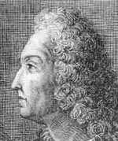
JACOB BERNOULLI (1655-1705)

Slide 19
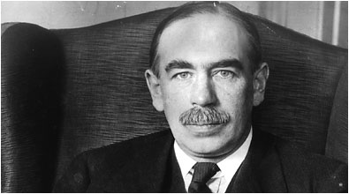
JOHN MAYNARD KEYNES (1883-1946)

Slide 20
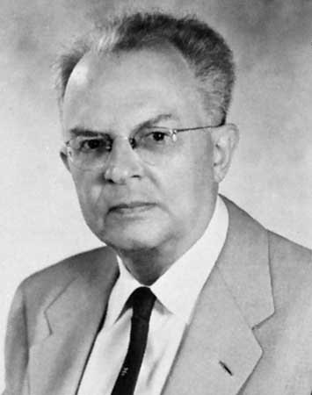
RUDOLF CARNAP (1891-1970)

Slide 21
“KNOWN TO WHOM?”
WELL, FOR YOUR BELIEFS: KNOWN TO YOU.

Slide 22
SO ROWE IS CORRECT IN SAYING THAT FRIENDLY ATHEISM MAKES GOOD SENSE
SOME THEISTS MAY HAVE CONSIDERED ALL OR MOST OF THE ARGUMENTS AND EVIDENCE FOR OR AGAINST THE EXISTENCE OF GOD AND CONCLUDED THAT THE BELIEF IS REASONABLE ON THAT BASIS. AS ROWE POINTS OUT THEY MAY ALSO HAVE HAD (OR APPEAL TO) RELIGIOUS EXPERIENCE.

Slide 23
“THAT’S DANDY, BUT HOW DO I DECIDE WHETHER THE BELIEF THAT GOD EXISTS IS REASONABLE ON MY EVIDENCE?”
DISAPPOINTING ANSWER: WE CAN TELL YOU CERTAIN FALLACIES TO AVOID AND HELP YOU EVALUATE THE VARIOUS ARGUMENTS, BUT IN THE END YOU MUST WEIGH IT UP FOR YOURSELF.

